Slide 1

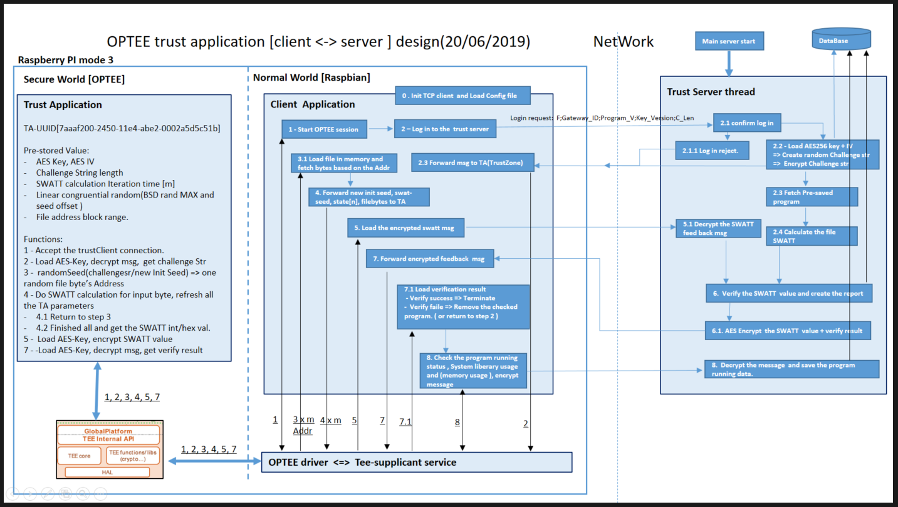
IOT Project Progress Report
Liu YuanCheng
2.1OI hardware architecture

Slide 2
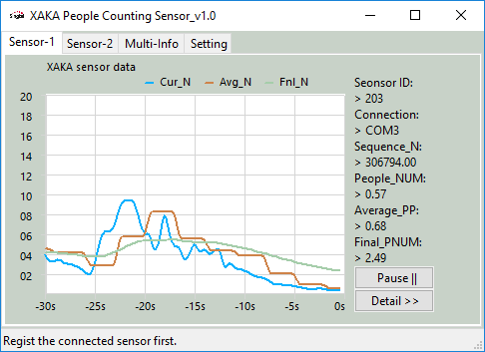
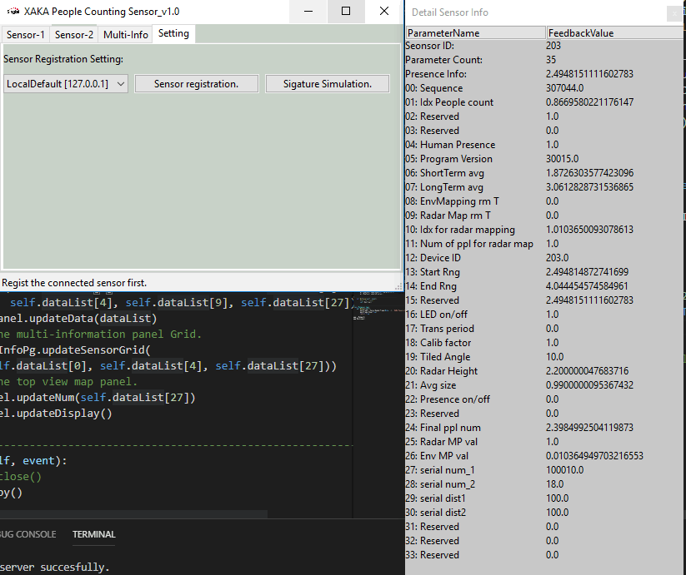
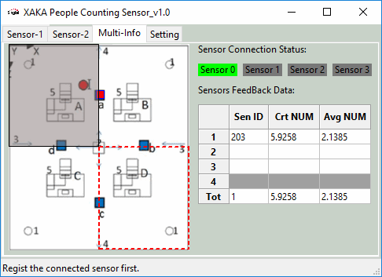
IOT Project Progress Report
Liu YuanCheng
2.1OI hardware architecture

Slide 3
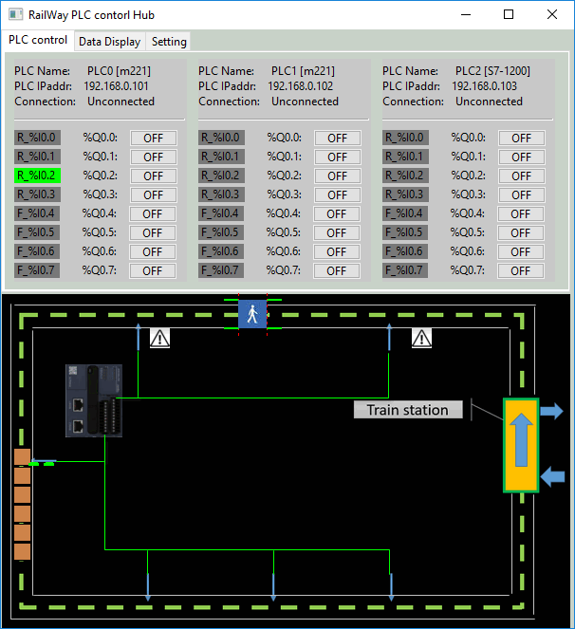
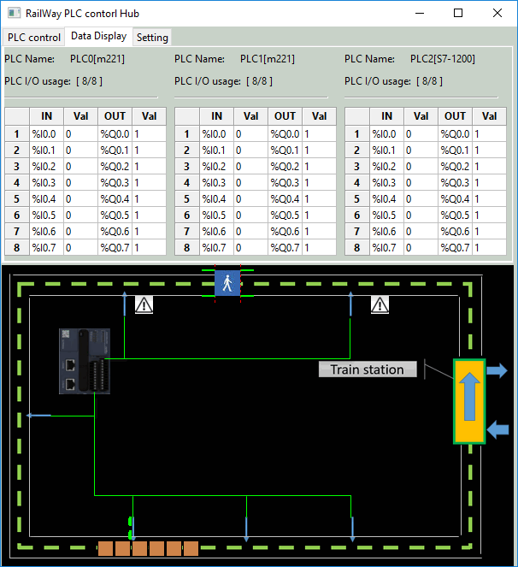
IOT Project Progress Report
Liu YuanCheng
2.1OI hardware architecture

